Slide 1
Storing Floating Point Numbers in Computer Memory
A floating point number is stored in memory as made up of three parts:
Sign
Exponent
Significant value

Slide 2
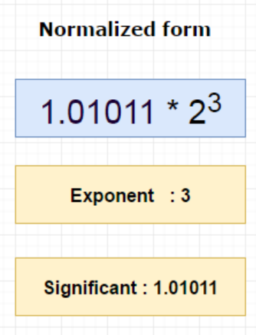
Storing Floating Point Numbers in Memory – Step 1: Significant Part
We need to convert the number into the normalized form
For floating point numbers, we need to normalize it as:
1.significant bit * 2 ^{exponent}
Decimal 10.75 = Binary 1010.11
So, 1010.11 will be normalized as: 1.01011 * 2³
Because, after the first 1, we write the decimal
point and then write the remaining digits
of the original number (i.e. 01011)
Significant part is 1.01011 in binary

Slide 3
Storing Floating Point Numbers in Memory – Step 2: Calculate Exponent
We do not use 2’s complement for floating point numbers
We need to add bias to the exponent, regardless of whether the number is positive or negative
bias_{n} = 2^{n-1} – 1 … Note n = Number of bits used for exponent
bias₈ = 2⁸ ⁻ ¹ -1 = 127
Hence the normalized exponent value will be:
Actual exponent = Exponent + bias value which is 3 + 127 = 130
So, the final exponent is 130
Binary form of 130 is 10000010₂

Slide 4
Storing Floating Point Numbers in Memory – Summary
Sign bit = 0, because 10.75 is positive
Exponent = 130, which is 10000010
Significant value is 1.01011, here we eliminate 1 before the dot (.) and just take the part after the dot, i.e. only 01011

Slide 5
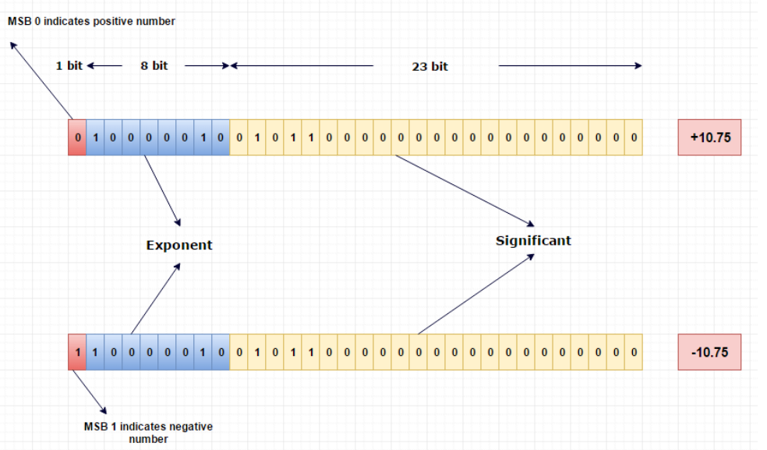
Storing Floating Point Numbers in Memory – End Result

Slide 6

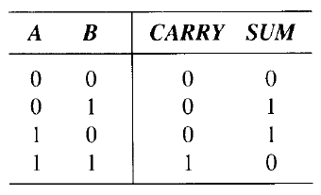
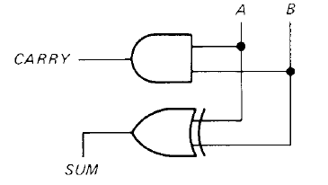
Half Adder
XOR
Half adder is a logic circuit that adds 2 bits
It produces two outputs: sum and carry
Sum = 1 when A and B are different (XOR gate)
Carry = 1 when A and B are 1 (AND gate)

Slide 7

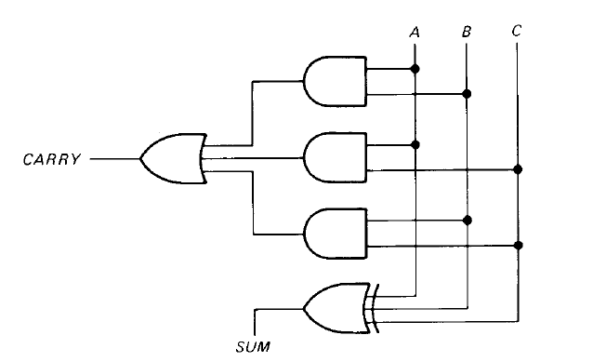
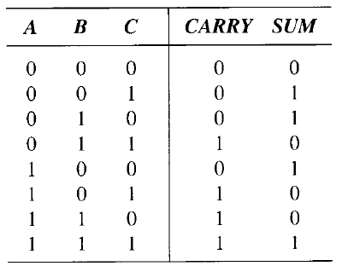
Full Adder
XOR is true when we have ODD number of 1s
Full adder is a logic circuit that can add 3 bits

Slide 8
Flip-flop
Gates are useful for decision-making – they can be used to perform addition and subtraction
Decision-making elements are not enough – a computer also needs memory elements to store bits
Flip-flops are used for memory elements
A flip-flop is a device with two stable states and it retains one of these two states until triggered into the other
A flip flop can store one bit of data

Slide 9
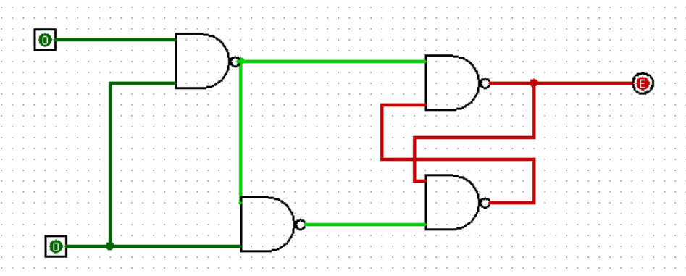
Creating a 1-Bit Computer Memory (i = Input, s = switch/trigger)
1
3
i
a
o
b
c
s
4
2

Slide 10
Understanding How It Works; s = 1 and i = 0 (Other combinations not described)
Suppose s = 1, i = 0
Since i and s go into gate 1, we have a = (1 NAND 0) = 1
Since a and s go into gate 2, we have b = (1 NAND 1) = 0
Since b is 0, which goes into gate 4, gate 4’s output: c = 1
Since c = 1 and a = 1, output of gate 3: o = (1 NAND 1) = 0
Now o, which is 0, goes back to gate 4 as the second input, once again c = (0 NAND 0) = 1
So, with s = 1, o = i = 0 and the 0 bit of input is retained as 0 in the output
1
3
i
a
o
b
c
s
4
2

Slide 11
Computer History

Slide 12
Computer Organization and Architecture
Computer organization: Physical aspects of a computer system (e.g. circuit design, control signals, memory types)
Computer architecture: Logical aspects of a computer as seen by a programmer (e.g. instruction sets, instruction formats, data types)

Slide 13
Organization Architecture
Also called microarchitecture or low level architecture
Transparent to the programmer (e.g. a programmer does not need to know how an addition operation is performed by the hardware)
Deals with physical components
How to do (Implementation)
High-level architecture
Programmer has to be aware of the instructions that are used
Deals with logical components (instruction set, addressing mode, data types)
What to do (Instruction set)

Slide 14
Brief History of Computers
Generation | Time Period | Details
0th (Mechanical computers) | 1642-1945 | Mechanical devices (e.g. Difference Engine and Analytical Engine of Charles Babbage) – See next slide Konrad Zuse’s calculating machines using electric relays John Atanasoff’s calculator
1st (Vacuum tubes) | 1945-1955 | COLOSSUS in England (Alan Turing), ENIAC (Mauchley and Eckert)
2nd (Transistors) | 1955-1965 | Digital Equipment Corporation (DEC) PDP-1, CDC 6600, Cray Supercomputers
3rd (Integrated Circuits or ICs) | 1965-1980 | IBM System/360 series of computers – Same assembly language, multiple computers, introduced multiprogramming,
4th (Very Large Scale Integration or VLSI) | 1980-Ongoing | IBM and other ‘cloned’ Personal Computers (PC), Apple Macintosh, CP/M and DOS operating systems, Intel 80836 chip in 1985 (x86)
5th (Low power and invisible computers) | 1990s onwards | PDAs, Smart phones, IoT

Slide 15
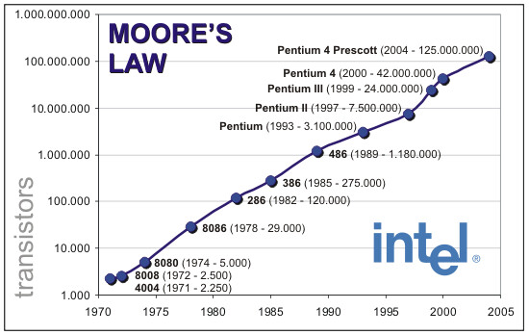
Computer Performance – Moore’s Law

Slide 16
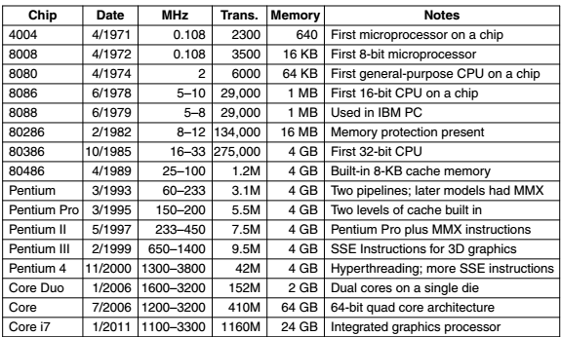
The Intel CPU Family

Slide 17
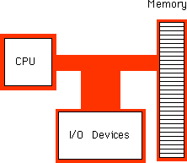
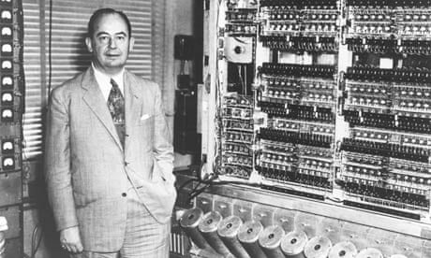
The von Neumann Architecture

Slide 18
The ‘Bus’ Concept

Slide 19
Computer Bus
The computer bus is a communication link (set of wires) used inside a computer to send data, addresses, control signals, and power to various hardware components
Buses connect various hardware components to each other
Bus types
Address bus: Connects CPU to RAM, used for specifying memory addresses for reading or writing of data
Data bus: Connects CPU to RAM, specifies data to be written or contains data that was read
Control bus: Connects CPU to RAM for passing control signals
Address bus + Data bus + Control bus = System bus

